Slide 1
Artificial Intelligence Lecture No. 5

Slide 2
Summary of Previous Lecture
What is an Intelligent agent?
Agents & Environments
Performance measure
Environment
Actuators
Sensors
Features of intelligent agents

Slide 3
Today’s Lecture
Different types of Environments
IA examples based on Environment
Agent types

Slide 4
Environments
Actions are done by the agent on the environment.
Environment provides percepts to the agent.
Determine to a large degree the interaction between the “outside world” and the agent
the “outside world” is not necessarily the “real world” as we perceive it
it may be a real or virtual environment the agent lives in
In many cases, environments are implemented within computers
They may or may not have a close correspondence to the “real world”

Slide 5
Properties of environments
Fully observable vs. partially observable
Or Accessible vs. inaccessible
If an agent’s sensory equipment gives it access to the complete state of the environment, then we say that environment is fully observable to the agent.
An environment is effectively fully observable if the sensors detect all aspects that are relevant to the choice of action.
A fully observable environment is convenient because the agent need not maintain any internal state to keep track of the world.

Slide 6
Properties of environments
Deterministic vs. nondeterministic.
If the next state of the environment is completely determined by the current state and the actions selected by the agents, then we say the environment is deterministic.
If the environment is inaccessible, then it may appear to be nondeterministic (bunch of uncertainties).

Slide 7
Properties of task environments
Episodic vs. sequential.
Agent’s experience is divided into “episodes.”
Each episode consists of the agent perceiving and acting.
Subsequent episodes do not depend on what actions occur in previous episodes.
In sequential environments current actions affect all succeeding actions

Slide 8
Properties of task environments
Static vs. Dynamic
If the environment can change while an agent is performing action, then we say the environment is dynamic.
Else its static.
Static environments are easy to deal with, because the agent does not keep on looking at the environment while it is deciding on an action.
Semidynamic: if the environment does not change with the passage of time but the agent performance score does.

Slide 9
Properties of environments
Discrete vs. continuous
If there are a limited number of distinct, clearly defined percepts and actions, we say that the environment is discrete.
Chess, since there are a fixed number of possible moves on each turn.
Taxi driving is continuous.

Slide 10
Properties of environments
Single agent vs. Multiagent
In the single agent environment there is only one agent
A computer software playing crossword puzzle
In multiagent systems, there are more than one active agents
Video games

Slide 11
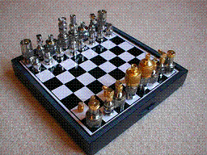
Environment Examples
Environment | Observable | Deterministic | Episodic | Static | Discrete | Agents
Chess with a clock
Chess without a clock
Fully observable vs. partially observable
Deterministic vs. stochastic / strategic
Episodic vs. sequential
Static vs. dynamic
Discrete vs. continuous
Single agent vs. multiagent

Slide 12
Environment Examples
Environment | Observable | Deterministic | Episodic | Static | Discrete | Agents
Chess with a clock | Fully | Strategic | Sequential | Semi | Discrete | Multi
Chess without a clock | Fully | Strategic | Sequential | Static | Discrete | Multi
Fully observable vs. partially observable
Deterministic vs. stochastic / strategic
Episodic vs. sequential
Static vs. dynamic
Discrete vs. continuous
Single agent vs. multiagent

Slide 13
Environment Examples
Environment | Observable | Deterministic | Episodic | Static | Discrete | Agents
Chess with a clock | Fully | Strategic | Sequential | Semi | Discrete | Multi
Chess without a clock | Fully | Strategic | Sequential | Static | Discrete | Multi
Poker
Fully observable vs. partially observable
Deterministic vs. stochastic / strategic
Episodic vs. sequential
Static vs. dynamic
Discrete vs. continuous
Single agent vs. multiagent

Slide 14
Environment Examples
Environment | Observable | Deterministic | Episodic | Static | Discrete | Agents
Chess with a clock | Fully | Strategic | Sequential | Semi | Discrete | Multi
Chess without a clock | Fully | Strategic | Sequential | Static | Discrete | Multi
Poker | Partial | Strategic | Sequential | Static | Discrete | Multi
Fully observable vs. partially observable
Deterministic vs. stochastic / strategic
Episodic vs. sequential
Static vs. dynamic
Discrete vs. continuous
Single agent vs. multiagent

Slide 15
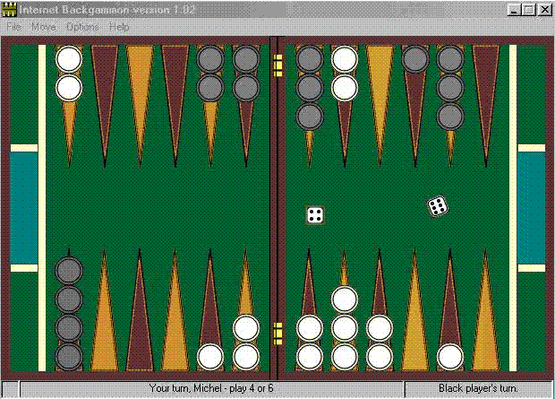
Environment Examples
Environment | Observable | Deterministic | Episodic | Static | Discrete | Agents
Chess with a clock | Fully | Strategic | Sequential | Semi | Discrete | Multi
Chess without a clock | Fully | Strategic | Sequential | Static | Discrete | Multi
Poker | Partial | Strategic | Sequential | Static | Discrete | Multi
Backgammon
Fully observable vs. partially observable
Deterministic vs. stochastic / strategic
Episodic vs. sequential
Static vs. dynamic
Discrete vs. continuous
Single agent vs. multiagent

Slide 16
Environment Examples
Environment | Observable | Deterministic | Episodic | Static | Discrete | Agents
Chess with a clock | Fully | Strategic | Sequential | Semi | Discrete | Multi
Chess without a clock | Fully | Strategic | Sequential | Static | Discrete | Multi
Poker | Partial | Strategic | Sequential | Static | Discrete | Multi
Backgammon | Fully | Stochastic | Sequential | Static | Discrete | Multi
Fully observable vs. partially observable
Deterministic vs. stochastic / strategic
Episodic vs. sequential
Static vs. dynamic
Discrete vs. continuous
Single agent vs. multiagent

Slide 17
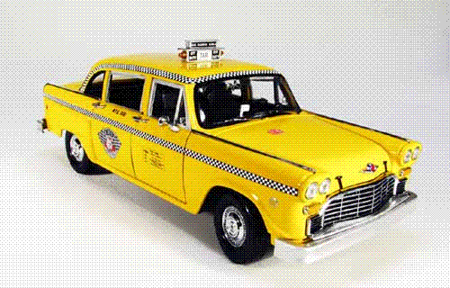
Environment Examples
Environment | Observable | Deterministic | Episodic | Static | Discrete | Agents
Chess with a clock | Fully | Strategic | Sequential | Semi | Discrete | Multi
Chess without a clock | Fully | Strategic | Sequential | Static | Discrete | Multi
Poker | Partial | Strategic | Sequential | Static | Discrete | Multi
Backgammon | Fully | Stochastic | Sequential | Static | Discrete | Multi
Taxi driving | Partial | Stochastic | Sequential | Dynamic | Continuous | Multi
Fully observable vs. partially observable
Deterministic vs. stochastic / strategic
Episodic vs. sequential
Static vs. dynamic
Discrete vs. continuous
Single agent vs. multiagent

Slide 18
Environment Examples
Environment | Observable | Deterministic | Episodic | Static | Discrete | Agents
Chess with a clock | Fully | Strategic | Sequential | Semi | Discrete | Multi
Chess without a clock | Fully | Strategic | Sequential | Static | Discrete | Multi
Poker | Partial | Strategic | Sequential | Static | Discrete | Multi
Backgammon | Fully | Stochastic | Sequential | Static | Discrete | Multi
Taxi driving | Partial | Stochastic | Sequential | Dynamic | Continuous | Multi
Medical diagnosis
Fully observable vs. partially observable
Deterministic vs. stochastic / strategic
Episodic vs. sequential
Static vs. dynamic
Discrete vs. continuous
Single agent vs. multiagent

Slide 19
Environment Examples
Environment | Observable | Deterministic | Episodic | Static | Discrete | Agents
Chess with a clock | Fully | Strategic | Sequential | Semi | Discrete | Multi
Chess without a clock | Fully | Strategic | Sequential | Static | Discrete | Multi
Poker | Partial | Strategic | Sequential | Static | Discrete | Multi
Backgammon | Fully | Stochastic | Sequential | Static | Discrete | Multi
Taxi driving | Partial | Stochastic | Sequential | Dynamic | Continuous | Multi
Medical diagnosis | Partial | Stochastic | Episodic | Static | Continuous | Single
Fully observable vs. partially observable
Deterministic vs. stochastic / strategic
Episodic vs. sequential
Static vs. dynamic
Discrete vs. continuous
Single agent vs. multiagent

Slide 20
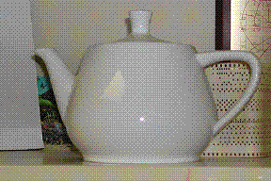
Environment Examples
Environment | Observable | Deterministic | Episodic | Static | Discrete | Agents
Chess with a clock | Fully | Strategic | Sequential | Semi | Discrete | Multi
Chess without a clock | Fully | Strategic | Sequential | Static | Discrete | Multi
Poker | Partial | Strategic | Sequential | Static | Discrete | Multi
Backgammon | Fully | Stochastic | Sequential | Static | Discrete | Multi
Taxi driving | Partial | Stochastic | Sequential | Dynamic | Continuous | Multi
Medical diagnosis | Partial | Stochastic | Episodic | Static | Continuous | Single
Image analysis
Fully observable vs. partially observable
Deterministic vs. stochastic / strategic
Episodic vs. sequential
Static vs. dynamic
Discrete vs. continuous
Single agent vs. multiagent

Slide 21
Environment Examples
Environment | Observable | Deterministic | Episodic | Static | Discrete | Agents
Chess with a clock | Fully | Strategic | Sequential | Semi | Discrete | Multi
Chess without a clock | Fully | Strategic | Sequential | Static | Discrete | Multi
Poker | Partial | Strategic | Sequential | Static | Discrete | Multi
Backgammon | Fully | Stochastic | Sequential | Static | Discrete | Multi
Taxi driving | Partial | Stochastic | Sequential | Dynamic | Continuous | Multi
Medical diagnosis | Partial | Stochastic | Episodic | Static | Continuous | Single
Image analysis | Fully | Deterministic | Episodic | Semi | Discrete | Single
Fully observable vs. partially observable
Deterministic vs. stochastic / strategic
Episodic vs. sequential
Static vs. dynamic
Discrete vs. continuous
Single agent vs. multiagent

Slide 22
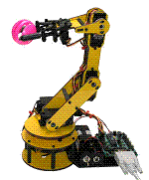
Environment Examples
Environment | Observable | Deterministic | Episodic | Static | Discrete | Agents
Chess with a clock | Fully | Strategic | Sequential | Semi | Discrete | Multi
Chess without a clock | Fully | Strategic | Sequential | Static | Discrete | Multi
Poker | Partial | Strategic | Sequential | Static | Discrete | Multi
Backgammon | Fully | Stochastic | Sequential | Static | Discrete | Multi
Taxi driving | Partial | Stochastic | Sequential | Dynamic | Continuous | Multi
Medical diagnosis | Partial | Stochastic | Episodic | Static | Continuous | Single
Image analysis | Fully | Deterministic | Episodic | Semi | Discrete | Single
Robot part picking
Fully observable vs. partially observable
Deterministic vs. stochastic / strategic
Episodic vs. sequential
Static vs. dynamic
Discrete vs. continuous
Single agent vs. multiagent

Slide 23
Environment Examples
Environment | Observable | Deterministic | Episodic | Static | Discrete | Agents
Chess with a clock | Fully | Strategic | Sequential | Semi | Discrete | Multi
Chess without a clock | Fully | Strategic | Sequential | Static | Discrete | Multi
Poker | Partial | Strategic | Sequential | Static | Discrete | Multi
Backgammon | Fully | Stochastic | Sequential | Static | Discrete | Multi
Taxi driving | Partial | Stochastic | Sequential | Dynamic | Continuous | Multi
Medical diagnosis | Partial | Stochastic | Episodic | Static | Continuous | Single
Image analysis | Fully | Deterministic | Episodic | Semi | Discrete | Single
Robot part picking | Fully | Deterministic | Episodic | Semi | Discrete | Single
Fully observable vs. partially observable
Deterministic vs. stochastic / strategic
Episodic vs. sequential
Static vs. dynamic
Discrete vs. continuous
Single agent vs. multiagent

Slide 24
Environment Examples
Environment | Observable | Deterministic | Episodic | Static | Discrete | Agents
Chess with a clock | Fully | Strategic | Sequential | Semi | Discrete | Multi
Chess without a clock | Fully | Strategic | Sequential | Static | Discrete | Multi
Poker | Partial | Strategic | Sequential | Static | Discrete | Multi
Backgammon | Fully | Stochastic | Sequential | Static | Discrete | Multi
Taxi driving | Partial | Stochastic | Sequential | Dynamic | Continuous | Multi
Medical diagnosis | Partial | Stochastic | Episodic | Static | Continuous | Single
Image analysis | Fully | Deterministic | Episodic | Semi | Discrete | Single
Robot part picking | Fully | Deterministic | Episodic | Semi | Discrete | Single
Interactive English tutor
Fully observable vs. partially observable
Deterministic vs. stochastic / strategic
Episodic vs. sequential
Static vs. dynamic
Discrete vs. continuous
Single agent vs. multiagent

Slide 25
Environment Examples
Environment | Observable | Deterministic | Episodic | Static | Discrete | Agents
Chess with a clock | Fully | Strategic | Sequential | Semi | Discrete | Multi
Chess without a clock | Fully | Strategic | Sequential | Static | Discrete | Multi
Poker | Partial | Strategic | Sequential | Static | Discrete | Multi
Backgammon | Fully | Stochastic | Sequential | Static | Discrete | Multi
Taxi driving | Partial | Stochastic | Sequential | Dynamic | Continuous | Multi
Medical diagnosis | Partial | Stochastic | Episodic | Static | Continuous | Single
Image analysis | Fully | Deterministic | Episodic | Semi | Discrete | Single
Robot part picking | Fully | Deterministic | Episodic | Semi | Discrete | Single
Interactive English tutor | Partial | Stochastic | Sequential | Dynamic | Discrete | Multi
Fully observable vs. partially observable
Deterministic vs. stochastic / strategic
Episodic vs. sequential
Static vs. dynamic
Discrete vs. continuous
Single agent vs. multiagent

Slide 26
Agent types
Four basic types in order of increasing generalization:
Simple reflex agents
Reflex agents with state/model
Goal-based agents
Utility-based agents

Slide 27
Simple Reflex Agent
Instead of specifying individual mappings in an explicit table, common input-output associations are recorded
Requires processing of percepts to achieve some abstraction
Frequent method of specification is through condition-action rules
if percept then action
If car-in-front-is-braking then initiate-braking
Similar to innate reflexes or learned responses in humans
Efficient implementation, but limited power
Environment must be fully observable
Easily runs into infinite loops

Slide 28
Simple reflex agents

Slide 29
Simple Reflex Agent
function SIMPLE-REFLEX-AGENT (percept) returns action
static: rules, a set of condition-action rules
state ← INTERPRET-INPUT (percept)
rule ← RULE-MATCH (state, rules)
action ← RULE-ACTION [rule]
return action

Slide 30
A simple reflex agent..
which works by finding a rule whose condition matches the current situation and then doing the action associated with that rule

Slide 31
Reflex agents with state/model
Evan a little bit of un observability can cause serious trouble.
The braking rule given earlier assumes that the condition car-in-front-is-braking can be determined from the current percept – the current video image.
More advanced techniques would require the maintenance of some kind of internal state to choose an action.

Slide 32
Reflex agents with state/model
An internal state maintains important information from previous percepts
Sensors only provide a partial picture of the environment
Helps with some partially observable environments
The internal states reflects the agent’s knowledge about the world
This knowledge is called a model
May contain information about changes in the world

Slide 33
Model-based reflex agents
Required information:
How the world evolves independently of the agent?
An overtaking car generally will be closer behind than it was a moment ago.
The current percept is combined with the old internal state to generate the updated description of the current state.

Slide 34
Model-based reflex agents

Slide 35
Model-based reflex agents
function REFLEX-AGENT-WITH-STATE (percept) returns an action
static: state, a description of the current world state
rules, a set of condition-action rules
action, the most recent action, initially none
state ← UPDATE-STATE (state, action, percept)
rule ← RULE-MATCH (state, rules)
action ← RULE-ACTION [rule]
state ← UPDATE-STATE (state, action)
return action

Slide 36
Goal-based agent
Merely knowing about the current state of the environment is not always enough to decide what to do next.
The right decision depends on where the taxi is trying to get to.
So the goal information is also needed.

Slide 37
Goal-based agent
Goal-based agents are far more flexible.
If it starts to rain, the agent adjusts itself to the changed circumstances, since it also looks at the way its actions would affect its goals (remember doing the right thing).
For the reflex agent we would have to rewrite a large number of condition-action rules.

Slide 38
Goal-based agents

Slide 39
Utility-based agents
Goals are not really enough to generate high-quality behavior.
There are many ways to reach the destination, but some are qualitatively better than others.
More safe
Shorter
Less expensive

Slide 40
Utility-based agent
We say that if one world state is preferred to another, then it has higher utility for the agent.
Utility is a function that maps a state onto a real number.
state → R
Any rational agent possesses a utility function.

Slide 41
Utility-based agents

Slide 42
Summery of Today’s Lecture
Different types of Environments
IA examples based on Environment
Agent types
Simple reflex agents
Reflex agents with state/model
Goal-based agents
Utility-based agents

